Slide 1
THANK YOU FOR DOWNLOADING!!
In case the embedded fonts don’t work, here are the download links:
Bodoni Moda
https://fonts.google.com/specimen/Bodoni+Moda?query=bodoni
Pinyon Script
https://fonts.google.com/specimen/Pinyon+Script?query=pinyon

Slide 2
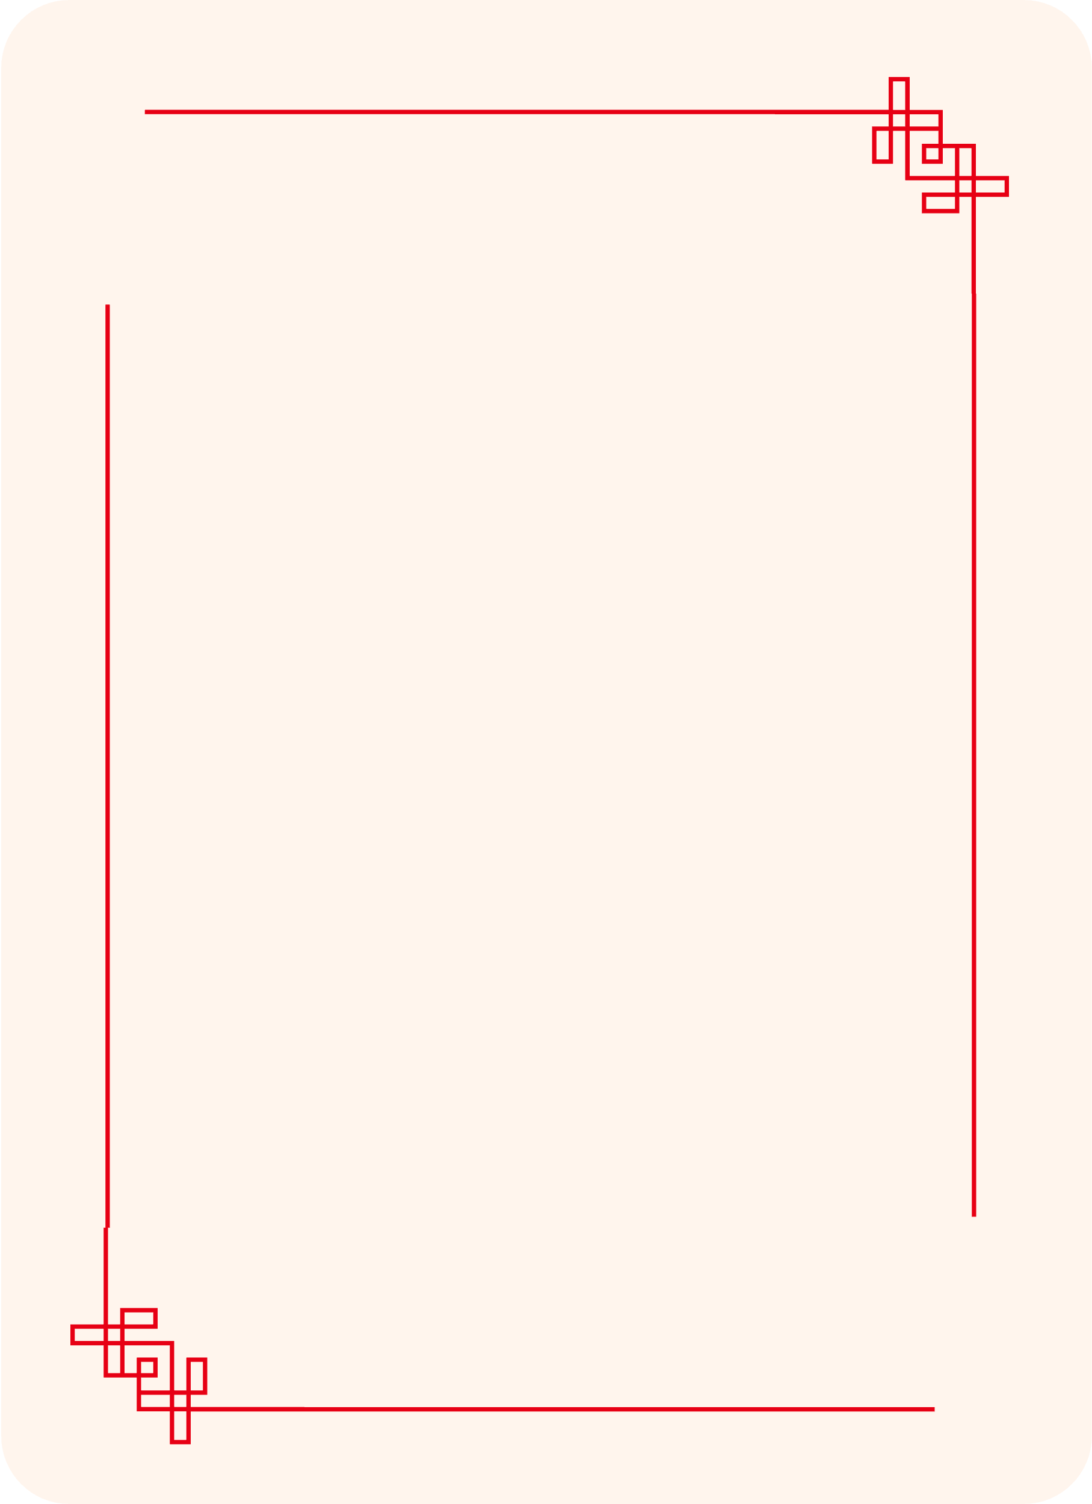


WRAPPED
Minnie’
KISSES
2022
5
4
5
3
4
2
2
1
3
1

Slide 3





5 PEOPLE
THIS YEAR, I KISSED
2
3
1
4
5
3
2
1
4
5
4
1
LIBRA
4
ARIES
1
3
GEMINI
2
3
CANCER
2
4
ARIES
4

Slide 4
THEIR SIGNS
2
1
3
1
2
4
3
3
5
2
1
1
4
2
3
4
4
2
5
1
3
LIBRA
ARIES
CANCER
ARIES
GEMINI
4
4
2
1
3

Slide 5
WHERE WE MET
1
2
3
1
2
Mutual friends
3
Bumble
Class project

Slide 6
POSITIVES
1
2
3
4
4
THEY WERE ALL HOT
ARIES
4
1
LIBRA
3
4
1
THE
2
2
3
ARIES
GEMINI
1
3
CANCER
2

Slide 7
POSITIVES
1
1
2
3
MOST WERE GOOD KISSERS
THE
2
3

Slide 8

POSITIVES
2
3
2
ONLY CRIED OVER ONE OF THEM
THE
3
1
2
3
1
2
3

Slide 9
NEGATIVES
3
3
THE
3
2
1
I DATED ZERO
3
2
1

Slide 10
NEGATIVES
THE
3
2
ONE ARIES WAS A HORRIBLE EXPEREINCE
1
3
2
1

Slide 11
NEGATIVES
THE
3
LIBRA’S FRIEND WAS CUTER
2
3
2

Slide 12
1
2
3
4
1
2
3
4

Slide 13
1
2
3
4
1
2
3
4

Slide 14













ASSETS

